Slide 1
New Horizons RP model instructions
Build your own New Horizons spacecraft model using your 3D printer
Files are available with the body whole or split vertically. Use the files based on your experience with your printer that are most likely to give you good results.
What you’ll need:
  SC body or body halves from your printer
  SC antenna from your printer
  SC RTG from your printer
  ¼” dowels (available at any hardware store)
  Adhesive for bonding parts together. (select an adhesive based on the media you are using in your 3D printer.

Slide 2
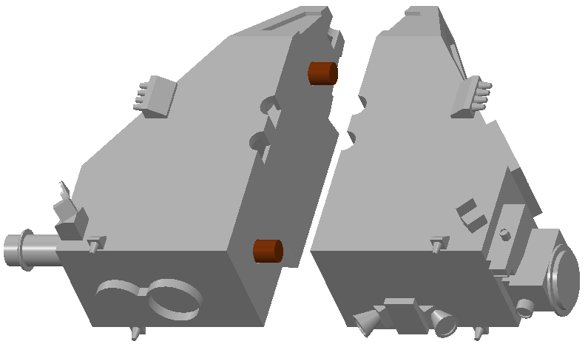
New Horizons 4 piece assembly instructions
2X Ø.25” x .50” dowels
Right body half
Left body half

Slide 3
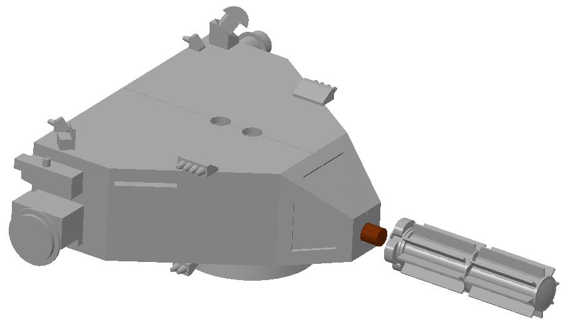
New Horizons 4 piece assembly instructions
Assembled body
Ø.25” x .50” dowel
RTG

Slide 4
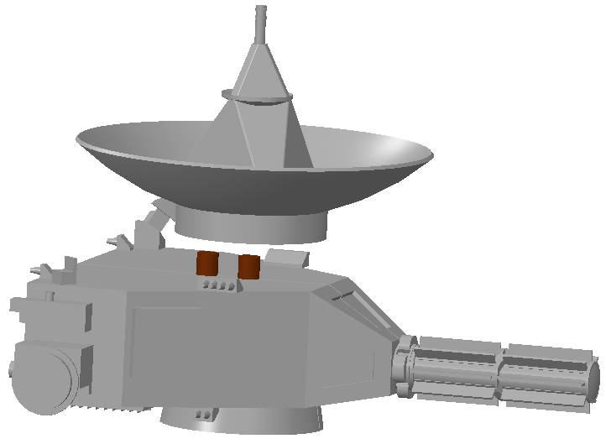
New Horizons 4 piece assembly instructions
Antenna
2X Ø.25” x .50” dowels
Body & RTG assembly

Slide 5
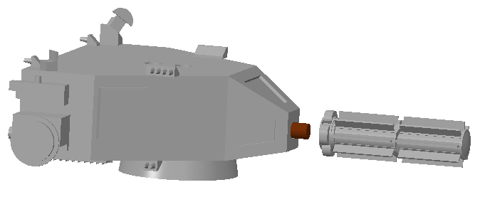
New Horizons 3 piece assembly instructions
Body
Ø.25” x .50” dowel
RTG

Slide 6
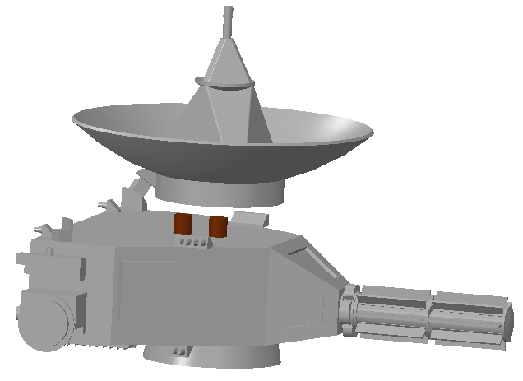
New Horizons 3 piece assembly instructions
Antenna
2X Ø.25” x .50” dowels
Body & RTG assembly

